Slide 1
FY 2024-2025 Annual Action Plan
City of West Palm Beach
Department of Housing and Community Development
June 11, 2024

Slide 2
Agenda
Consolidated Planning Process & Overview of HUD Programs
PY 2022-2023 Accomplishments and Current Projects
PY 2024-2025 Proposed Action Plan Activities
Comments from the Public
Notes:
To provide an overview of our federal funding available each year and eligible uses of each fund.
To hear from you about the housing and community development needs and priorities within the city.

Slide 3
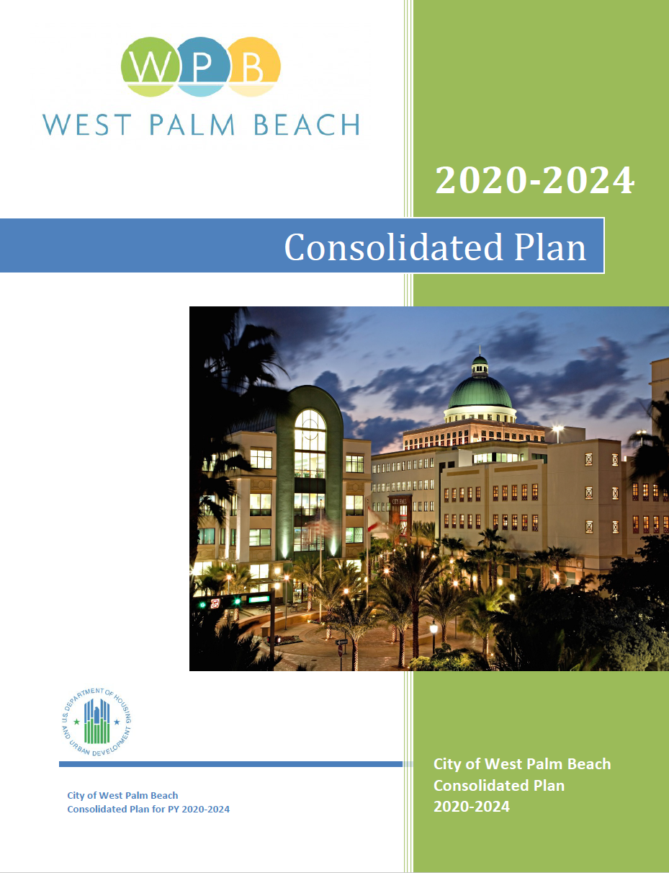
Consolidated Planning Process
A Consolidated Plan (24 CFR Part 91) is the 5-year plan submitted to the U.S. Department of Housing and Urban Development (HUD) that serves as the comprehensive housing affordability strategy, community development plan, and submission for funding under the following federal formula grant programs:
Community Development Block Grant (CDBG) Program
HOME Investments Partnership Program (HOME)
Housing Opportunities for Persons with AIDS (HOPWA) Program
Notes:
5-year Consolidated Plan (Con Plan) describes a jurisdiction’s community development priorities and multiyear goals based on an assessment of housing and community development needs, an analysis of housing and economic market conditions and available resources.
Required to be completed by all HUD entitlement communities.

Slide 4
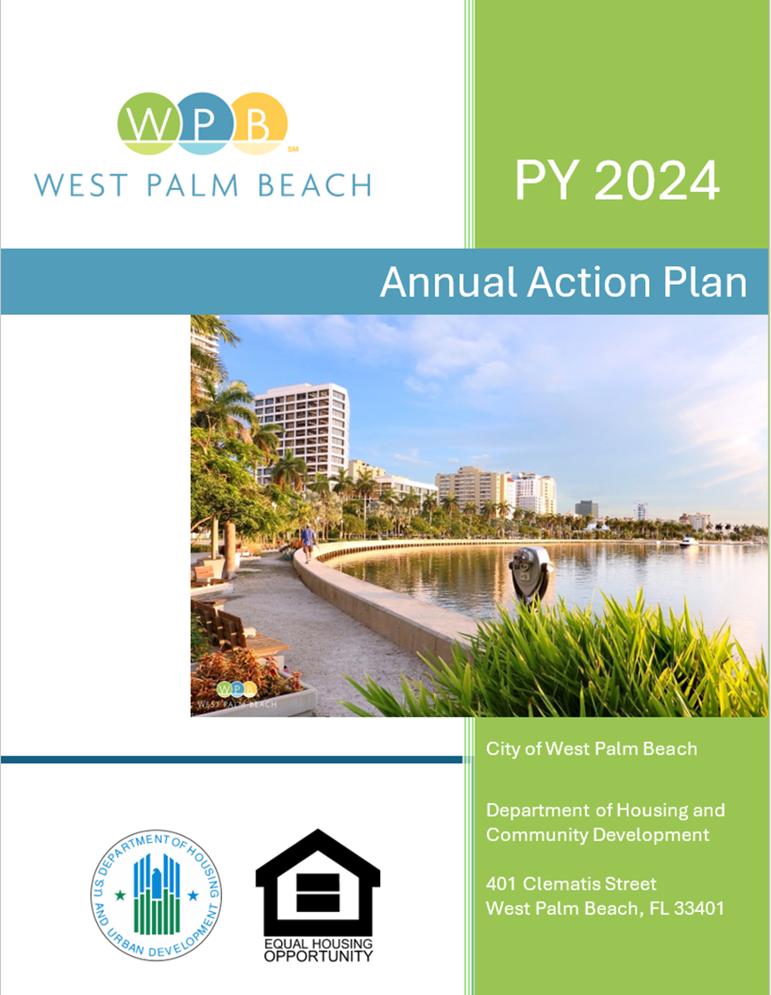
Annual Action Plan
The Consolidated Plan is carried out through an Annual Action Plan which provides a concise summary of the activities, projects, and specific federal and non-federal resources that will be used each year.
This Plan covers the activities that will be undertaken during the FY 2024 program year October 1, 2024 – September 30, 2025.
Main Sections:
Expected Resources
Annual Goals and Objectives
Projects
Notes:
The Annual Action Plan (AP) is submitted to HUD every year during the five-year Con Plan cycle. Describes the specific planned uses for HUD programs, and other program requirements.

Slide 5
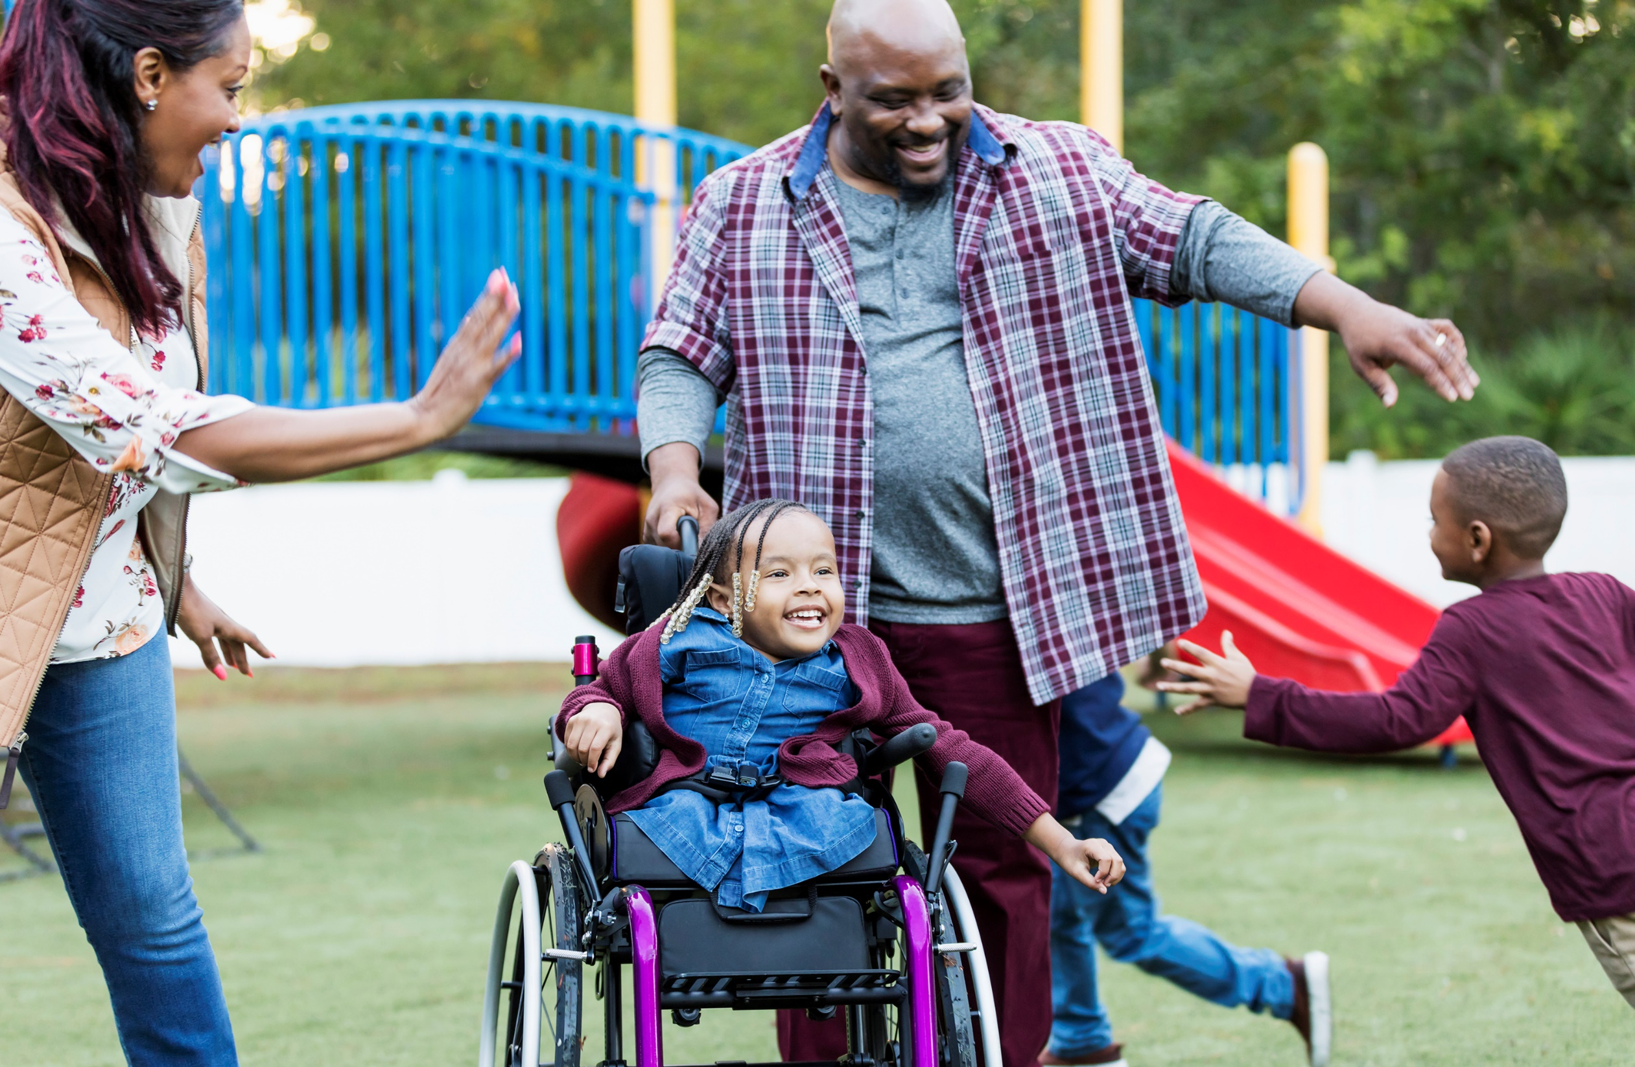
PY 2022/23 Accomplishments
Notes:
Grantees report on accomplishments and progress toward Consolidated Plan goals in the prior year.

Slide 6
Summary of PY22 Annual Performance Report
PY Goals/Objectives 22-23 (October 1, 2022 – September 30, 2023)
Public Facilities and Infrastructure
Affordable Housing
Homelessness Assistance and Public Services
Resources and Investments
Program | Resources Made Available | Expenditures during PY 22-23*
CDBG | $988,328 | $1,190,112
HOME | $550,987 | $50,896
HOPWA | $3,244,080 | $3,215,002
TOTAL | $4,783,395 | $4,456,010
CDBG-CV | $745,769 | $737,370
HOME-ARP | $1,734,257 | $2,577
HOPWA-CV | $144,217 | $120,725
TOTAL | $2,624,243 | $860,672
* Includes expenditures of funds from prior year resources and/or program income

Slide 7
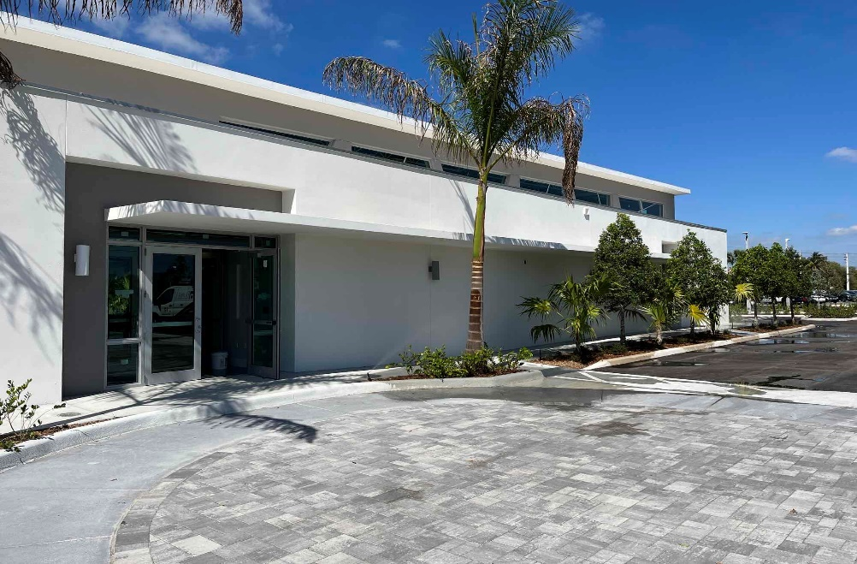
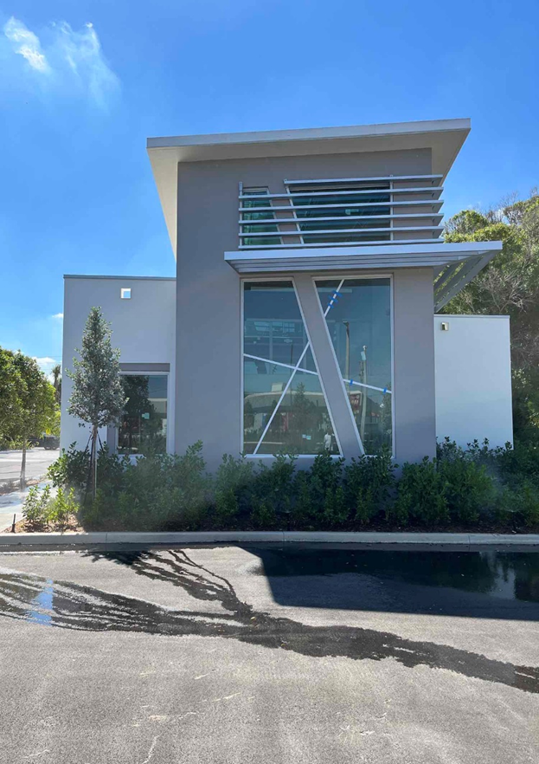
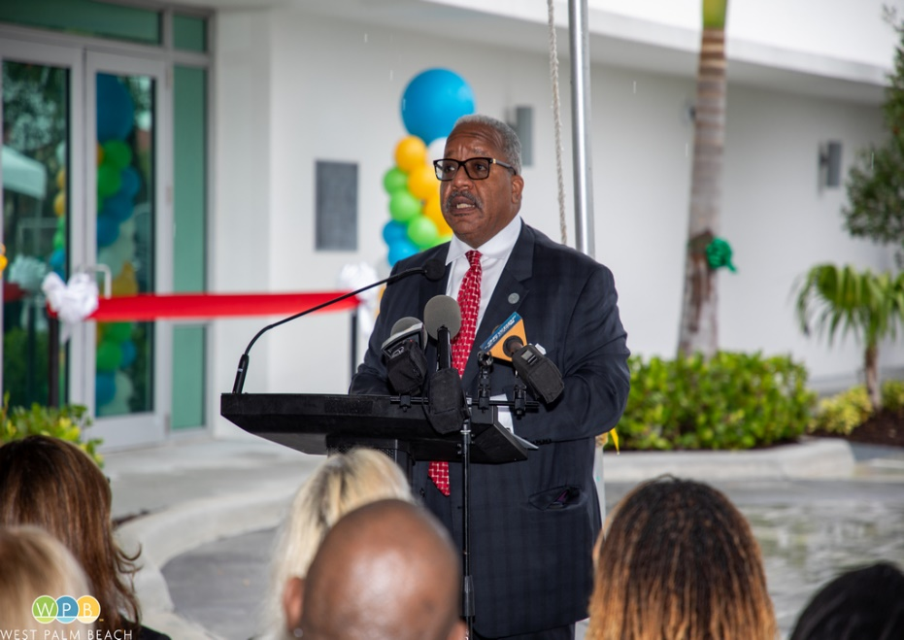
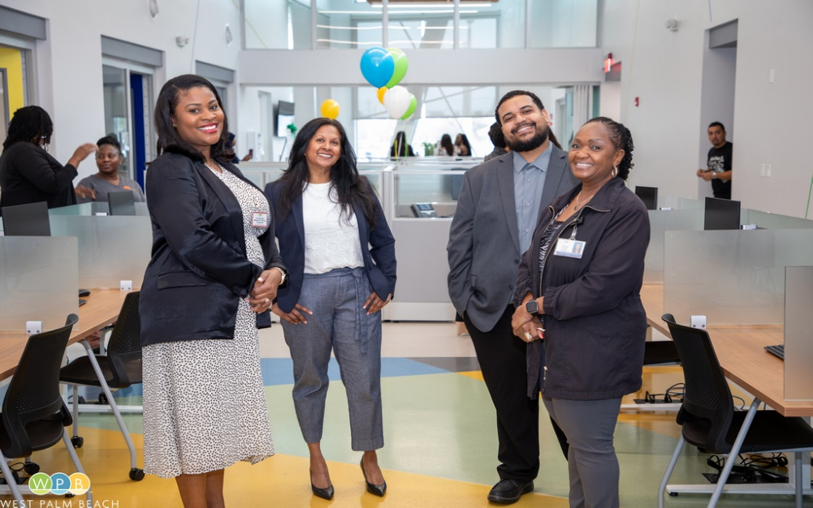
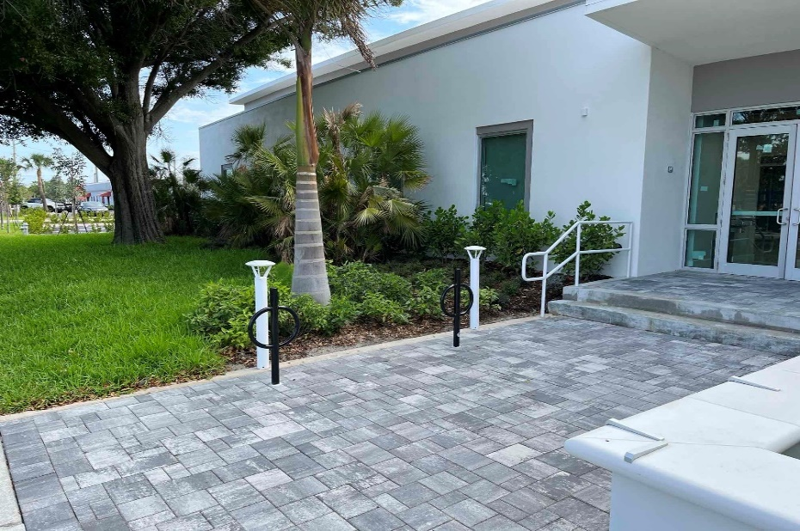
Public Facilities and Infrastructure
Construction of Eva W. Mack Community Hub (completed May 2023)

Slide 8
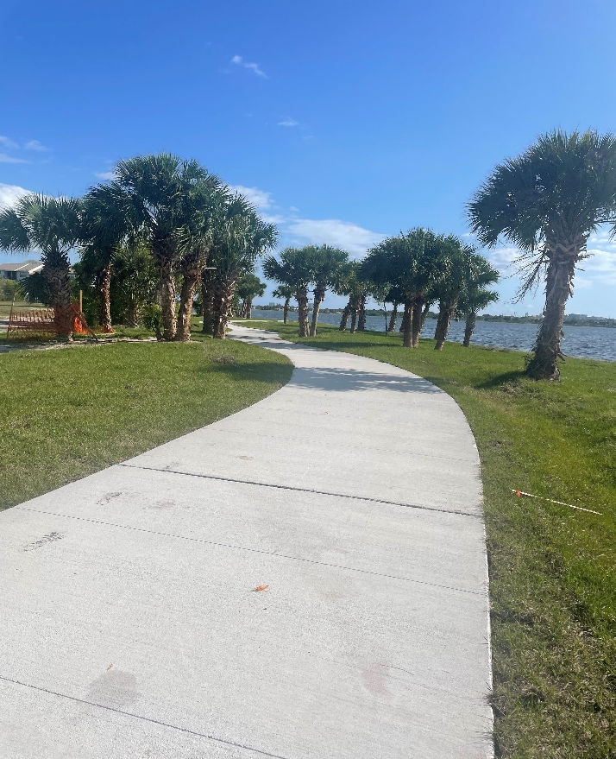
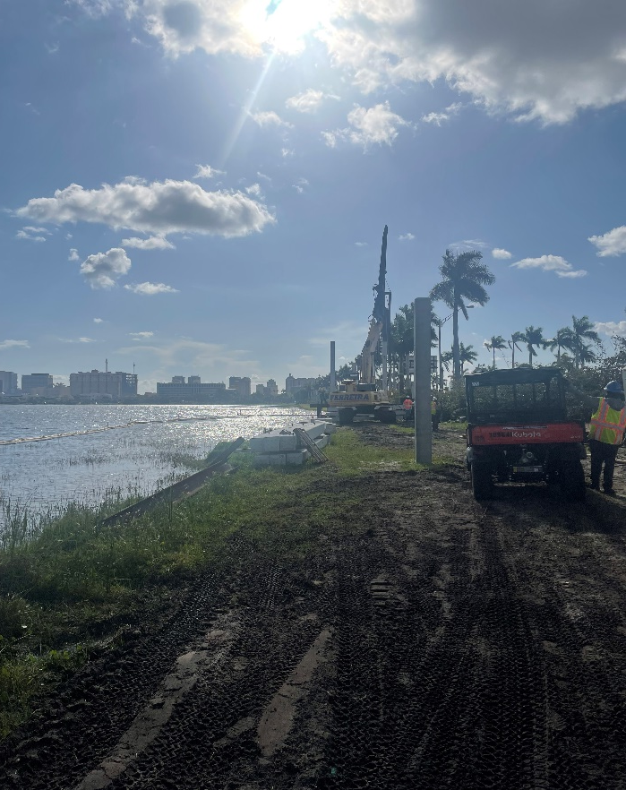
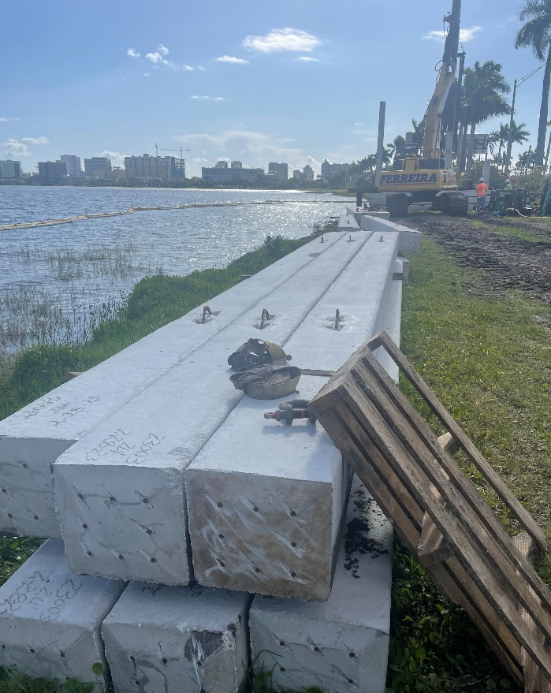
Public Facilities and Infrastructure
Clear Lake Multipurpose Trail Improvements
Approximately 6,000 foot-long, 10ft wide concrete paved path and boardwalk along the western shoreline of Clear Lake. Connecting PB Lakes Blvd. to Okeechobee Blvd for increased recreational opportunities, safe and convenient bicycle, and pedestrian access.

Slide 9
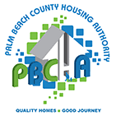
Affordable Housing
HOPWA/ HOPWA-CV
Provided tenant-based rental assistance and supportive services to individuals and families living with HIV/AIDS through a program administered by the Palm Beach County Housing Authority: 226 households assisted
Provided short-term rent/ mortgage/ utility assistance and hotel/motel leasing to individuals living with HIV/AIDS and impacted by COVID-19: 41 persons assisted
Utilized permanent housing placement funds to establish households in housing units by paying security deposits through a program implemented by the PBC Community Services Department: 9 persons assisted

Slide 10
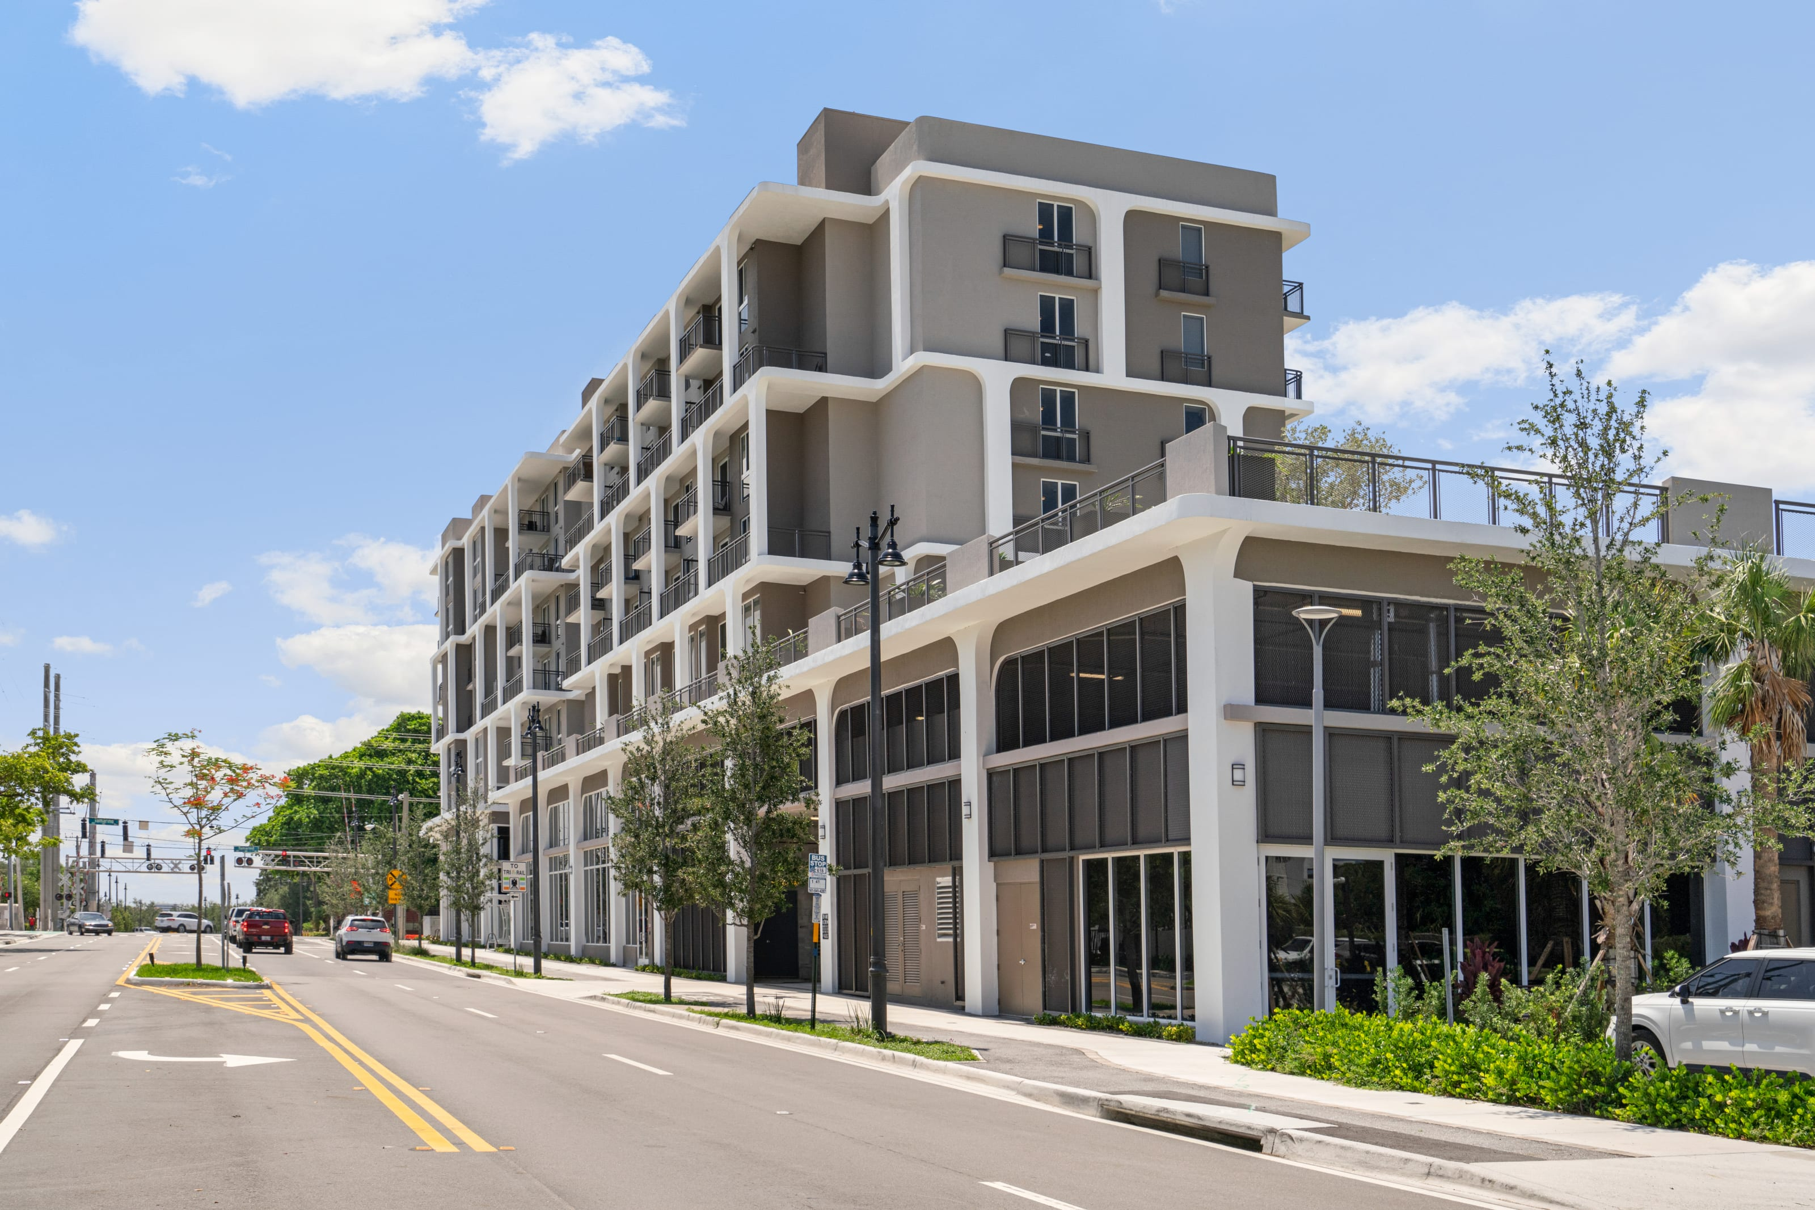
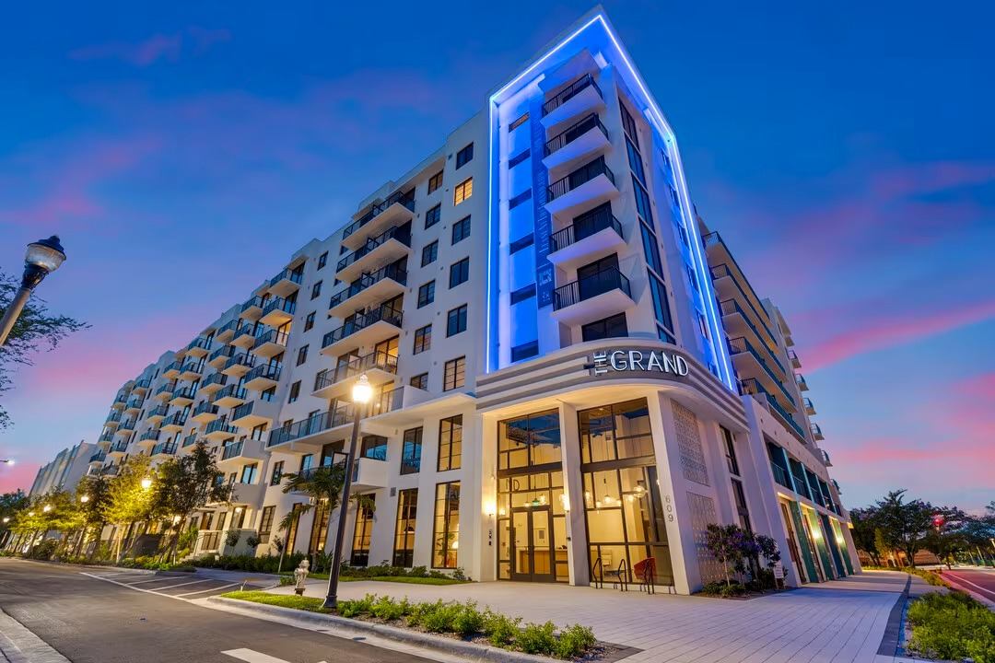
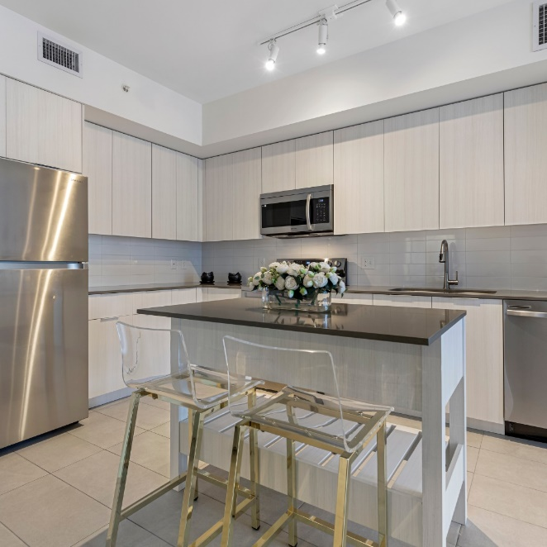
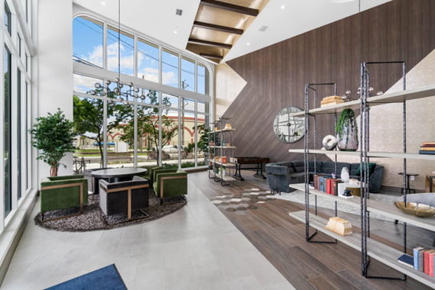
Affordable Housing Projects Completed
Flagler Station
The Grand
Address:
991 Banyan Blvd.
Total Units: 94
Affordable Units: 94
Income Level served: 30-80% AMI
Funding Source:
Local Housing Trust Fund
Address:
620 3rd St.
Total Units: 309
Affordable Units: 206
Income Level served: 60-140% AMI
Funding Source:
Local Housing Trust Fund & TIF

Slide 11
Homelessness/Public Services
HCD Community Services Division:
246 individuals experiencing chronic homelessness were connected to housing.
86 individuals experiencing chronic homelessness were reconnected with a loved one or family member.
317 individuals were provided with referrals and access to mental health and substance abuse resources.
165 local businesses and community groups were provided education and resources.
232 requests for assistance were submitted and addressed through the City’s online Homeless Activity Reporter (HAR).
1,485 engagements were conducted through city parks, neighborhoods and targeted areas.
Housing Stabilization Program (HSP) provides one-time financial assistance to families and individuals to gain or maintain housing stability: 23 households assisted

Slide 12
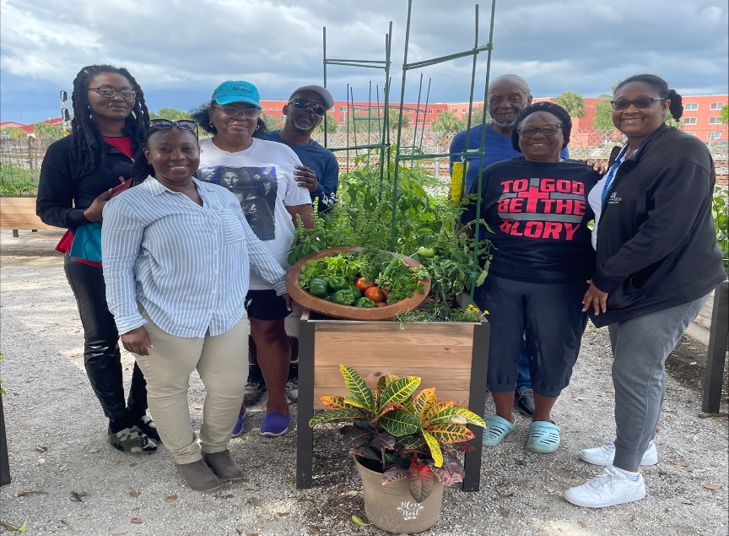
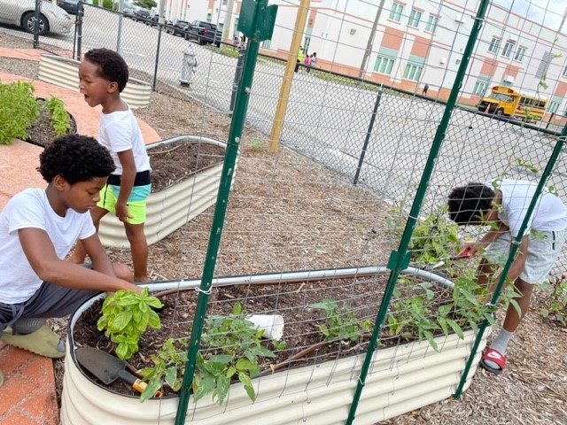
Homelessness/Public Services
Provided utility assistance to low- and moderate-income, elderly residents through the Serving our Seniors (SOS) Program: 2 persons assisted
Provided financial support to Esperanza Community Center for the salary and benefits of a community health outreach worker responsible for providing COVID-19 related health services and education, personal protective equipment, and referrals to community resources: 535 persons assisted
Partnered with Florida Agricultural and Mechanical University (FAMU) to launch two community gardens and educational programs in neighborhoods that have limited access to grocery stores, lack healthy food choices, and where food insecurity was exacerbated by the COVID-19 pandemic: 328 persons assisted

Slide 13
PY 2024/25 Action Plan Proposed Activities

Slide 14
2024 Action Plan - CDBG
TOTAL CDBG Entitlement Funding $ 1,039,077
Public Services (15%) $ 155,861
Planning and Administration (20%) $ 207,815
Public Facilities/Infrastructure Improvements $ 675,400
Notes:
Flexible funding source that can be used for a variety of activities targeted towards low to moderate income individuals, households and neighborhoods (80% Area Median Income and below). Eligible uses include:
Public Infrastructure Improvements
Public Facilities Improvements
Rehabilitation of residential and non-residential buildings
Acquisition of land or real property to be used for eligible purposes
Economic Development Activities
Public Services (15%)
Planning and Administration (20%)

Slide 15
2024 Action Plan - HOME
TOTAL HOME Entitlement Funding $ 492,244
Community Housing Development Organization
(CHDO) Set-Aside (15%) $ 73,836
HOME Program Administration (10%) $ 49,224
New Construction/Housing Development $ 369,183
Plus – Any Program Income accumulated throughout PY 23/24 ~ $34,059 as of 4/2024

Slide 16
2024 Action Plan - HOPWA
TOTAL HOPWA Funding $3,670,002
Tenant-Based Rental Assistance & Supportive Services $3,310,709
Project Sponsor Administration (7%) $249,193
Grantee Program Administration (3%) $110,100

Slide 17
What’s Ahead for the Action Plan
7/22/2024
City Commission Approval of FY 2024 Action Plan
8/16/2024
Action Plan due to HUD
8/16/2024- 9/30/2024 HUD Approval
10/1/2024 First day of Program Year 2024-2025
6/22/2024 – 7/22/2024
30-day comment period

Slide 18
Questions or Comments from the Public

Slide 19
Any other comments and/or questions, please contact:
Kimberly Spence HCD Assistant Director ksspence@wpb.org 561-822-1250
http://wpb.org/housing

